Slide 1



BKMD Capital Partners
Predicting Pneumonia from X-Ray Images
Gates Foundation Presentation
Telephone
Address
Website
February 2024
+212-515-3200
9 W 57 St., New York,
NY 10019
www.bkmd/capitalpartners.com

Slide 2
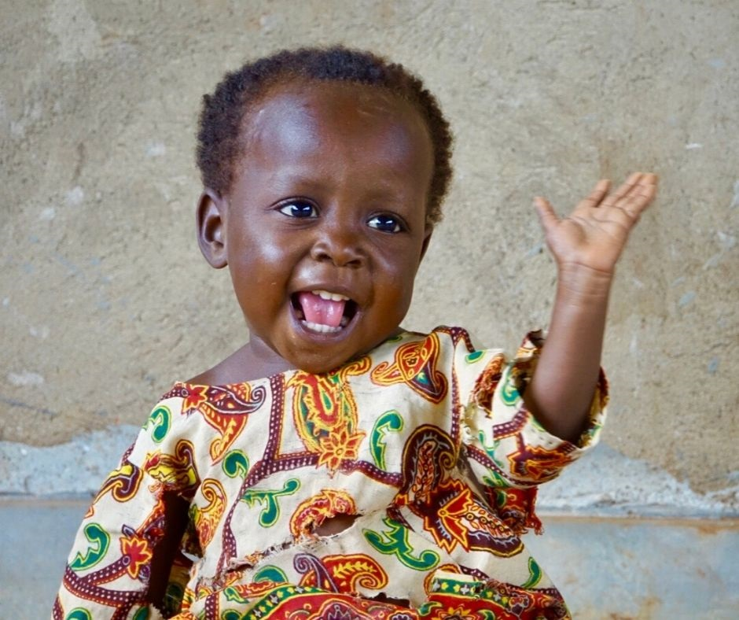
Meet Ruth
2 year old from Malawi Mangochi District
Notes:
10,000 deaths per year children under 5

Slide 3

TABLE OF CONTENTS
01
04
What is Pneumonia?
Investment
BKMD Capital
02
05
Model Description
Projected Timeline
03
06
Cost Benefit Analysis
Solution

Slide 4
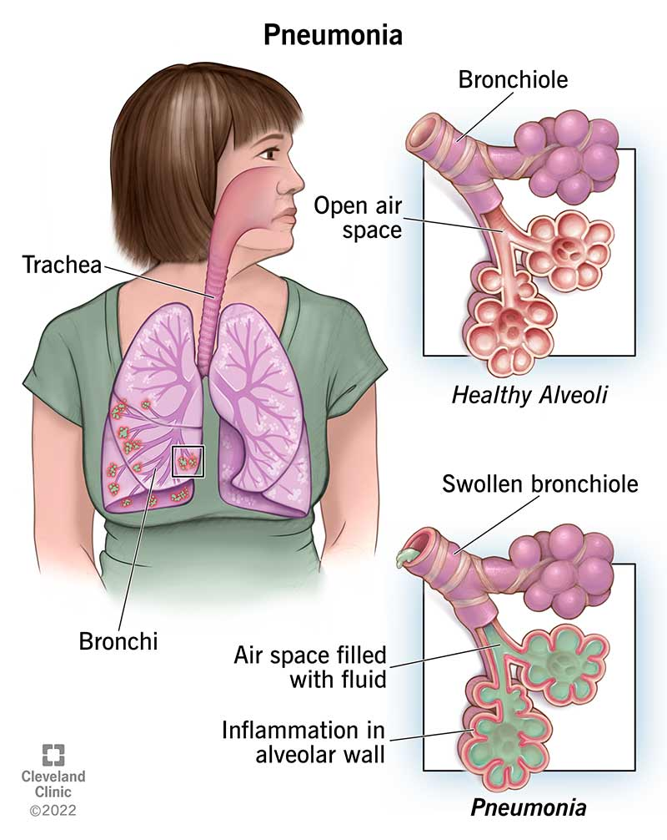
What is Pneumonia?
Infection of the lungs
> 1 million hospitalizations
> 50,000 deaths
Causes inflammation and fluid in air sacs
Alveoli unable to do gas exchange
Symptoms: cough, fever, shortness of breath, fatigue, chest pain
Transmission: Bacterial or viral
Complications: Respiratory failure, sepsis, death
Treatment: Antibiotics
Notes:
caused by bacteria, a virus or fungi. It is often spread via coughing, sneezing, or even breathing,

Slide 5
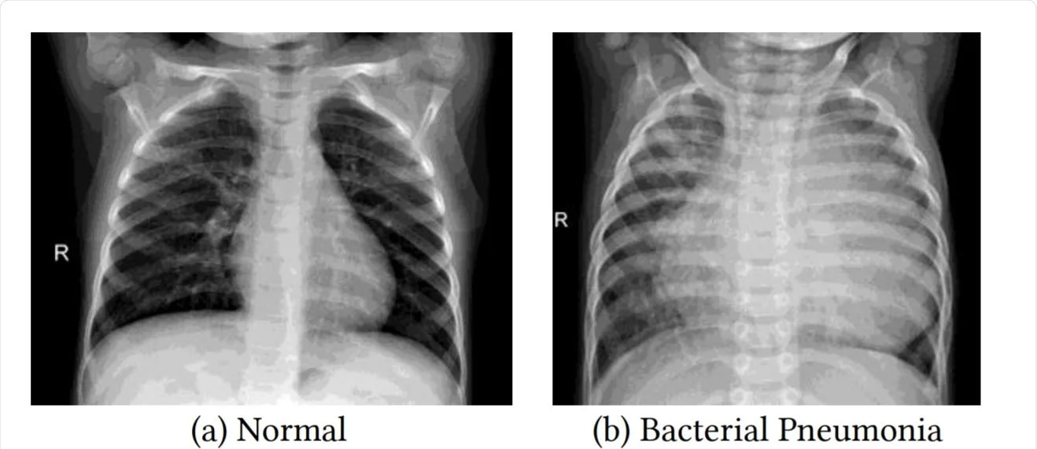

Diagnosing Pneumonia
Methods
Chest X-ray
Blood tests (CBC)
Pulse oximetry
Procalcitonin
Interstitial opacity in upper lobe
(Blurred area indicates infection or fluid)
Symptoms
Notes:
white spots in the lungs (called infiltrates) that identify an infection.
pleural effusions (fluid surrounding the lungs)
a. Note the obvious combined interstitial and alveolar filling infiltrates, as well as an air bronchogram (red arrow).
CBC- complete blood count, high white cell count means fighting an infection
opacity in left lobe of lung
dark= fluid, infection,
infection in upper space
can’t tell if blood or fluid
how to present to attending: rotation and penetration (over or under) of X ray
look for thoracic processes on spine
Anterior posterior view
little to no rotation b/c clavicals are even and equal
good penetration no rotation
airway
trachea, make sure its midline with no shift, no shifting
look at bones (clavicle, no breaks) no fractures
cardiac silhouette enlarged if hypertension, looks within range
diaphragm,
e, lung fields, see interstitial opacity in upper lobe, could reflect infection
air bronchogram,
interstitium is stuff around alveoli
in normal person you won’t see opacity (white)
in sick you will see opacity
ground glass opacity- hazyness
procalcitonin levels, tells if bacterial

Slide 6

Pediatric Pneumonia in Malawi
226,000 Annual Pediatric Pneumonia Cases
10,000 deaths per year children under 5
HIV/AIDS Highly Prevalent
1.1 million Malawians have HIV
HIV attacks CD4 cells
Weakens immune systems
Higher susceptibility to Pneumonia
Notes:
-HIV weakens the immune system by attacking CD4 cells
CD4= helper T cells or T cells, are an important part of your immune system. CD4 cells fight off infections and keep you from getting sick.

Slide 7
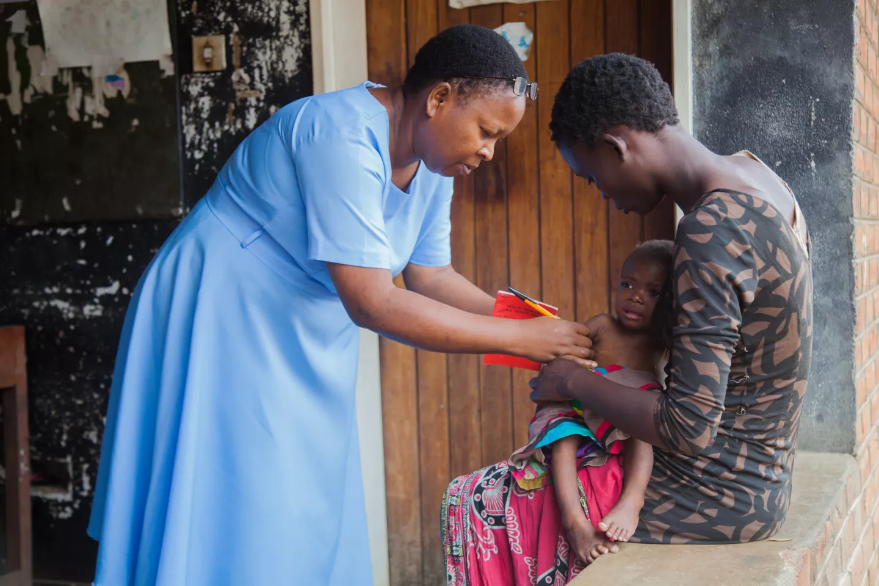
Why Malawi would benefit from our intervention
Desperate socio-economic scenario
Poverty (more than half of population living on <$1.25 per day)
Disease
Environmental Concerns
Lack of infrastructure
14% children are orphans with limited healthcare
Limited resources (medical equipment and personnel)

Slide 8
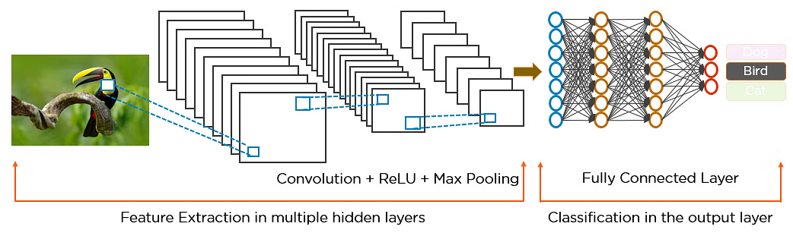
Convolutional Neural Network
(CNN)
01
Spatial Hierarchies
Identify high and low level patterns
02
Translate Invariance
Identify patterns no matter location
03
Adaptability
Augmentation allows various size and quality of data

Slide 9
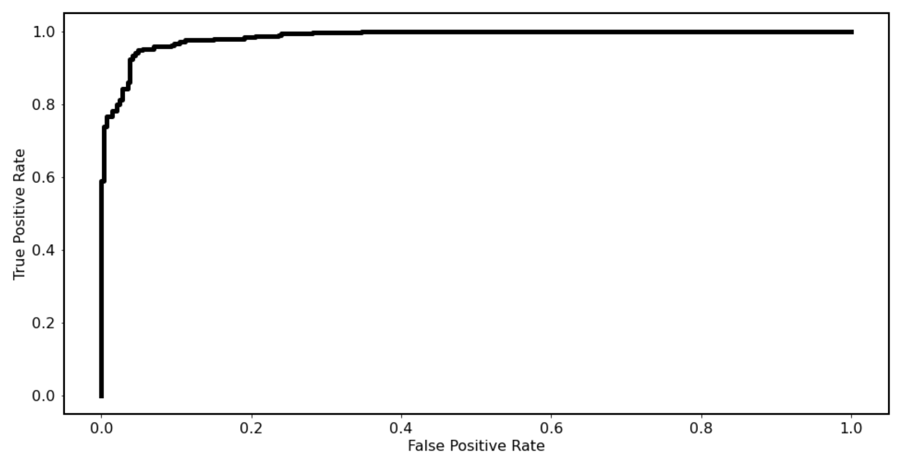

Model Evaluation
Area Under Curve (AUC)
From brand positioning and messaging to visual identity, we guide you through every step.
Accuracy =
Correct Predictions
Total Predictions
Navigate the path to increased sales with our insightful report and offering a strategic roadmap.
AUC > Accuracy
Amplify your revenue streams, engage customers, and unlock the full potential of your business.

Slide 10
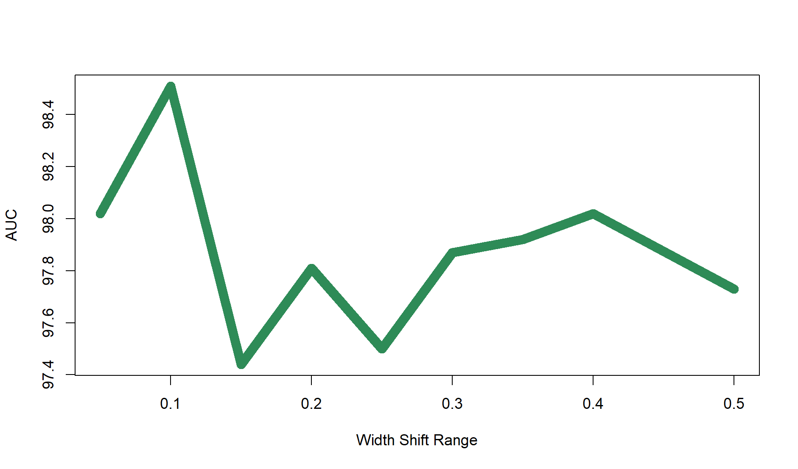
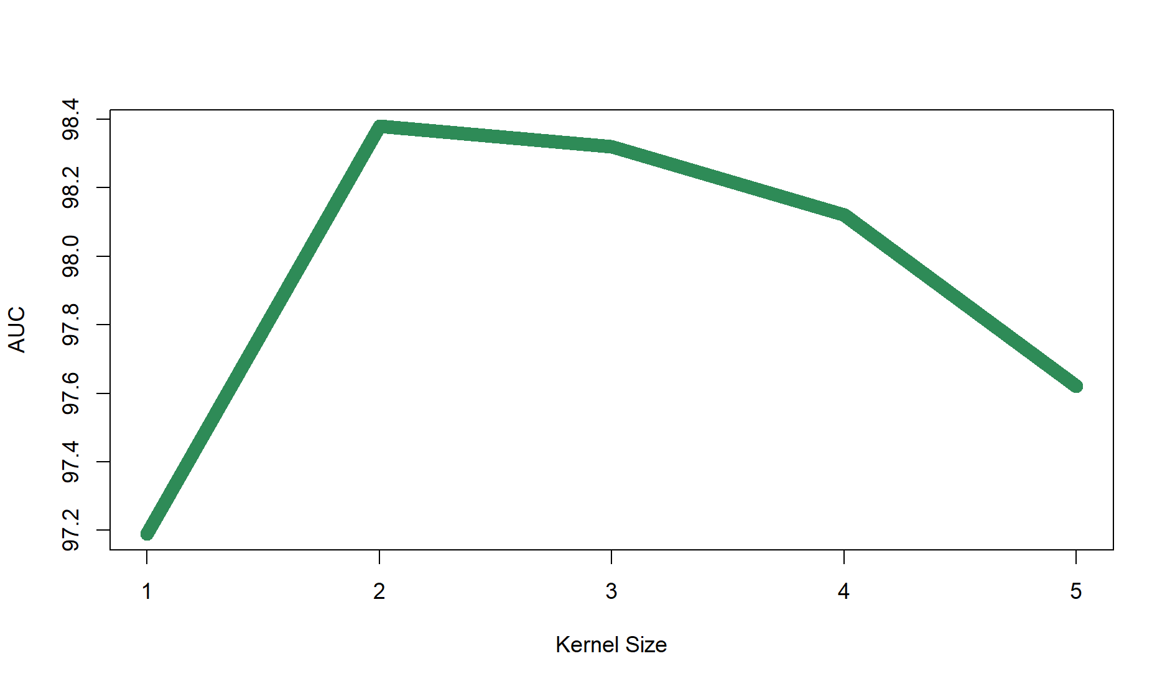
Process
Experimentation
Structured Approach
Isolate each parameter: find optimal
Kernel Size
Balance small and large patterns
Epochs
Give model enough time to learn
Augmentation
Allow model to be adaptable
Art and Science
Considered relationships of each parameter
Layers | Epochs
Kernel Size | Max Pooling

Slide 11
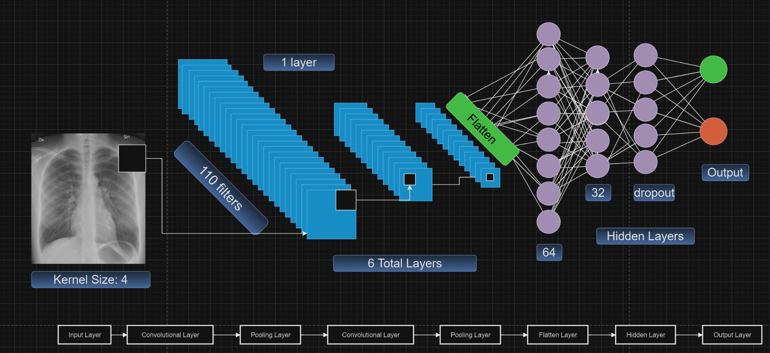
Rotation Range | 15
Width Shift Range | 0.1
Height Shift Range | 0.2
Horizontal Flip | True
Vertical Flip | True
Shear Range | 0.2
Zoom Range | 0.2
Number of Layers | 6
Number of Filters | 110
Kernel Size | 4
Dropout Value | 0.25
Max Pooling | 2
Number of Classes | 2
Batch Size | 40
Learning Rate | 0.0001
Epochs | 30
Model Architecture

Slide 12
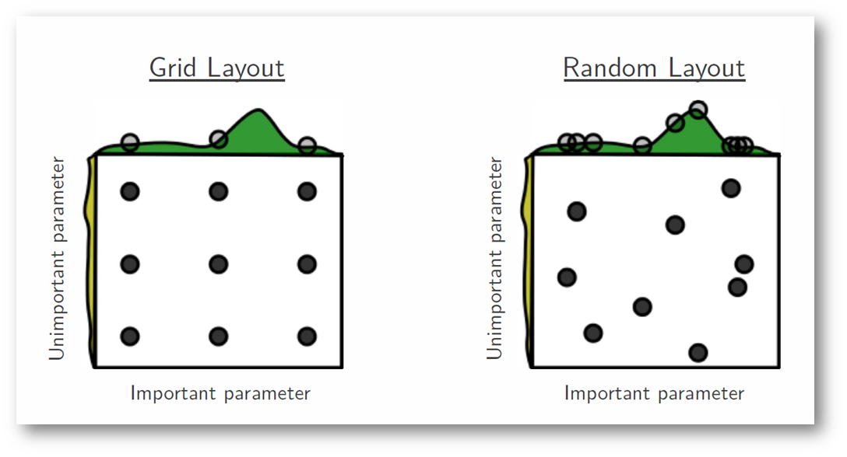
Next Steps for Model
More Experimentation with Relationships
Grid Search Approach

Slide 13




Intervention
Current State
Using our Model to Automate Process
94% Detection Accuracy
85% Detection Accuracy
4% False Positive
2% False Negative
Develops treatment plan
7.5% False Positive
7.5% False Negative

Slide 14
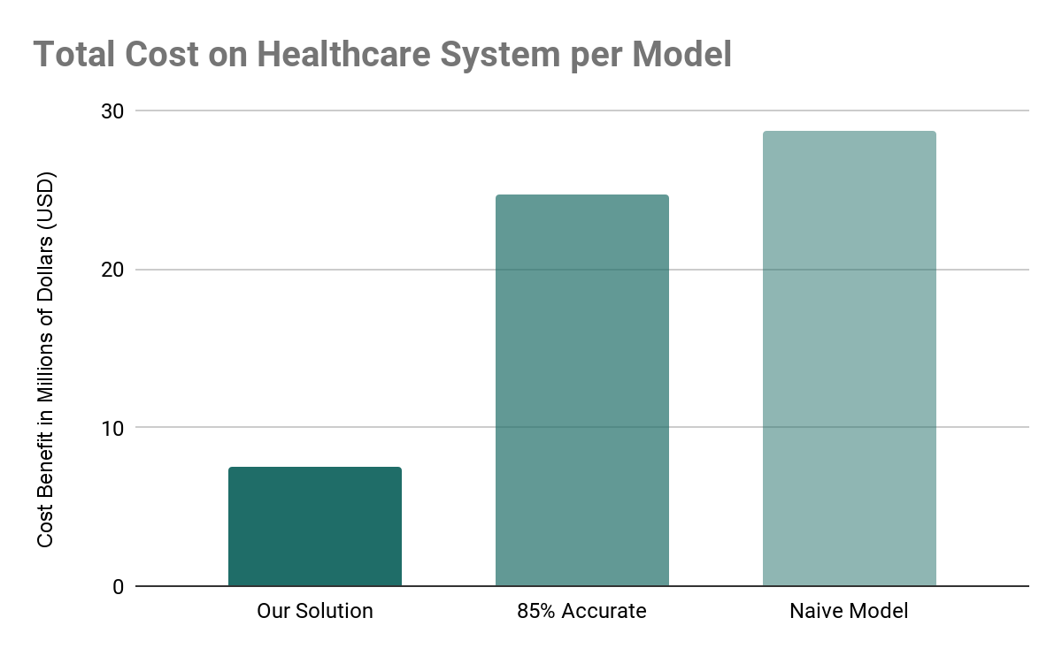
Cost Benefit Analysis
BKMD Capital
Annual Pediatric Pneumonia
$28.7M
Malawi Population ………………………..…….. 19.890M
Children Under 5 in Africa ……………..….. 207.449M
African Population ………………………………….. 1.216B
% of Children Under 5 …………….……….…….. 17%
Children Under 5 in Malawi ……….………….. 3.393M
Pneumonia Rate………………..……………..….. 6.65%
$24.7M
$7.5M
225,650 Sick Children
$24.7M – $7.5M = $17.2M in Cost Savings with our Model Solution

Slide 15
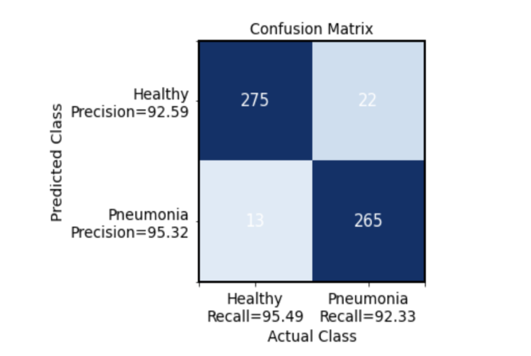
Cost Benefit Analysis
BKMD Capital
False Negative Costs
Current 85% Accurate Model
Naive Model
Oxygen Therapy ……………………… $29.28
Vasopressors ……………………………….. $18
% of Patients in ICU ……………….……. 30%
ICU Stay ………….……………… $3,632.67
Traumatologist Salary …….….. $13.12
False Positives: 43 (7.5%)
False Negatives: 43 (7.5%)
True Positives: 244
True Negatives: 245
False Positives: 288 (50.1%)
False Negatives: 0 (0%)
True Positives: 287
True Negatives: 0
$24.7M
$28.7M
$1,108.04
Our Solution
False Positive Costs
False Positives: 13 (2.26%)
False Negatives: 22 (3.83%)
True Positives: 265
True Negatives: 275
Wasted Medication ………………… $0.46
Healthcare Professional ………….. $2.25
Non-ICU Hospital ……………….……. $119
Respiratory Therapy ………………..….. $4
Return to Hospital ………………….... $119
$7.5M
$244.71

Slide 16
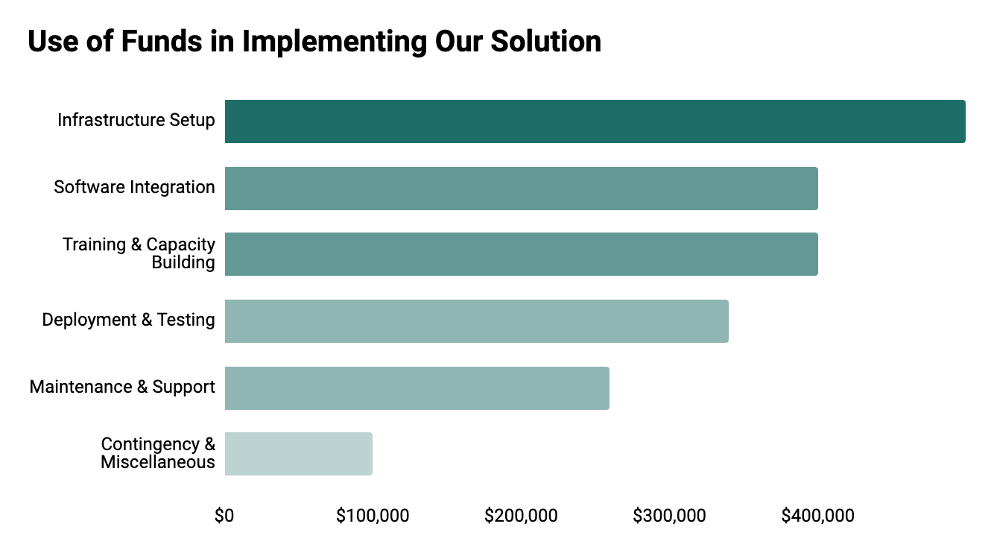
Cost Breakdown
BKMD Capital
How far will this $2M go?
25%
22%
20%
15%
13%
5%

Slide 17

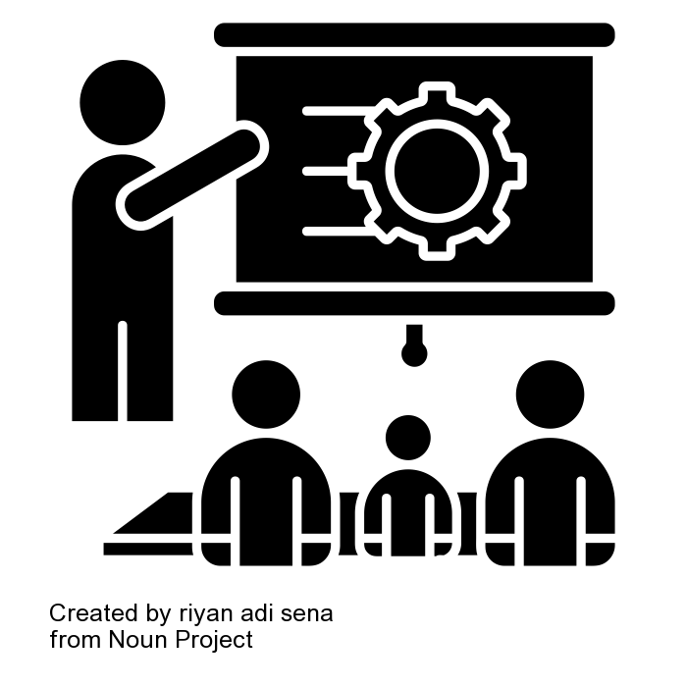

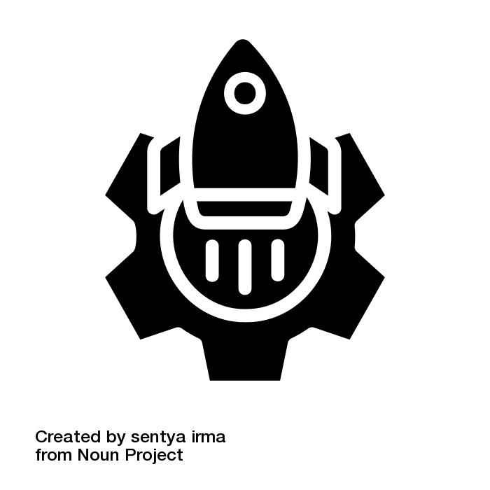


Cost Breakdown
BKMD Capital
How far will this $2M go?
Infrastructure Setup
Training & Capacity Building
Software Integration
Deployment & Testing
Maintenance & Support
Miscellaneous
$500K
$440K
$400K
$300K
$260K
$100K
25%
22%
20%
15%
13%
5%
Servers, GPUs, & Storage Systems
Reliable Internet Connectivity & Backup Power
Cloud solution integration
Ethical considerations for Data Security
Workshops, seminars, & training sessions
Integrate with U.S. radiologists
Educational Materials and guides
Travel allocation to conduct training & oversight
Integrate CNN model into existing healthcare network
Customized network if necessary
Customize user interfaces & dashboards
Thorough testing
Further development costs
Deployment of trained individuals & necessary software
Establish workflows & protocols for data collection, annotation & feedback
Train local technicians
Dedicated Malawi based support team
Partner with U.S. based team for oversight
Implement monitoring & alert systems
constant updates & enhancements
Unforeseen expenses & emergencies
Free Cash to integrate this system into other disease lines or hospital needs

Slide 18
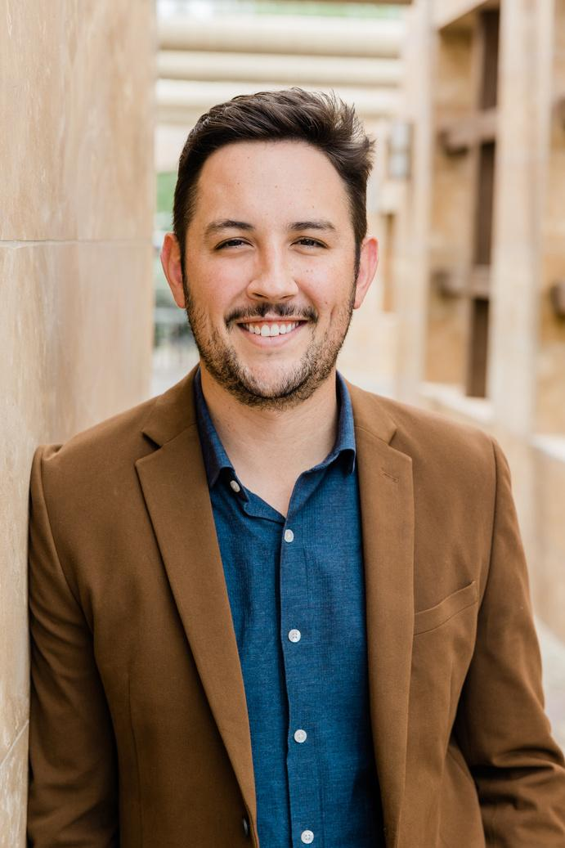





Projected Timeline
BKMD Capital
Years 1-4
Years 5-10
Years 10+
1. Implement technology in Malawi
2. Expand across villages
4. Expand to other countries in Sub-Saharan Africa
5. Expand the model across other diseases (heart disease)
10. Open first fully automated radiologist office, determine if it is possible for an automated clinic
15. Open the first fully automated doctors office in the world
Malawi is the perfect test population
20. Expand to other countries

Slide 19

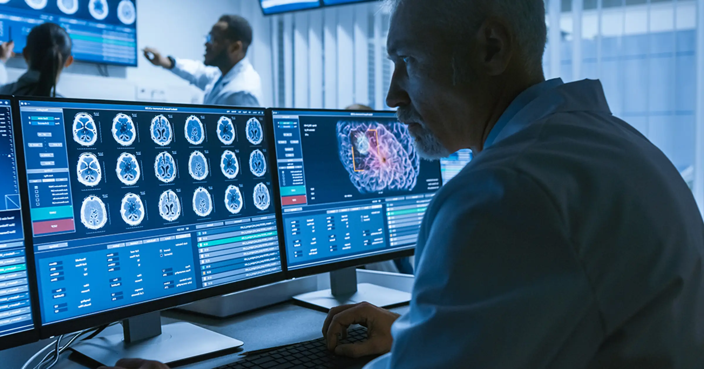
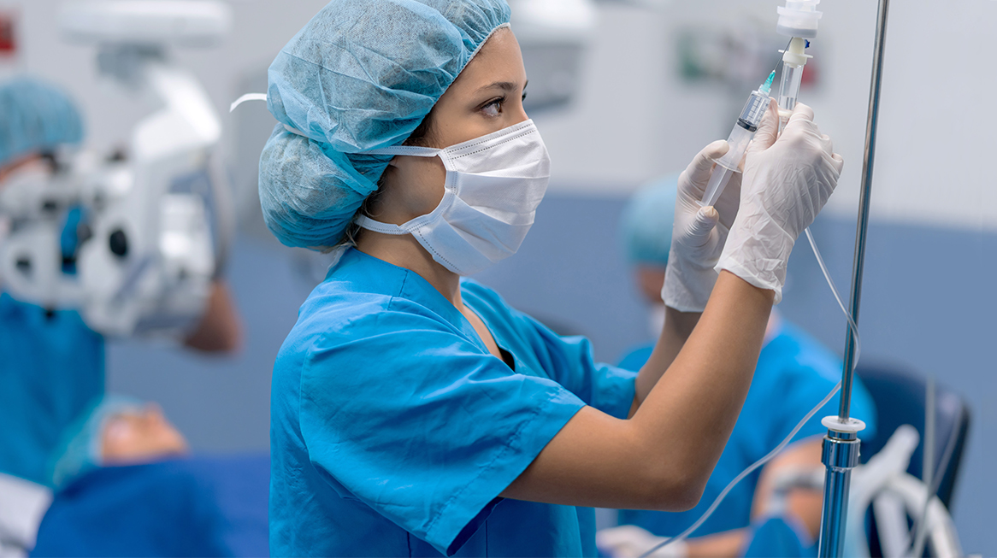



Automated Clinic
BKMD Capital
WHAT WE COULD DO…
Patient Arrival at Kiosk
Test Selection Automation
Nurse Intervention
The patient will arrive at the kiosk and be able to express how they are feeling and and what they have been experiencing
Our model will then provide specific diagnostic tests to be administered to the individual at the clinic
Nurses will be instrumental in assisting this process and properly administering tests (drawing blood, taking blood pressure, etc.),

Slide 20


SOLUTIONS
01
What is Malawi Children’s Village?
Malawi Children’s Village Partnership
“Our mission is to enhance the lives of orphans by providing health, social and educational resources in 39 villages along the southwest shore of Lake Malawi”
Village-based care for vulnerable children
02
Expanding our technology
We plan to bring the BKMD technology into places where it can have the most valuable impact on society– hence there is no better place than the Malawi Children’s Village to save lives
03
Changing lives
By leveraging our advanced technology we hope to transcend the lives of Sub-Saharan children. We will closely monitor the results of our work and best implement strategies for improvement

Slide 21
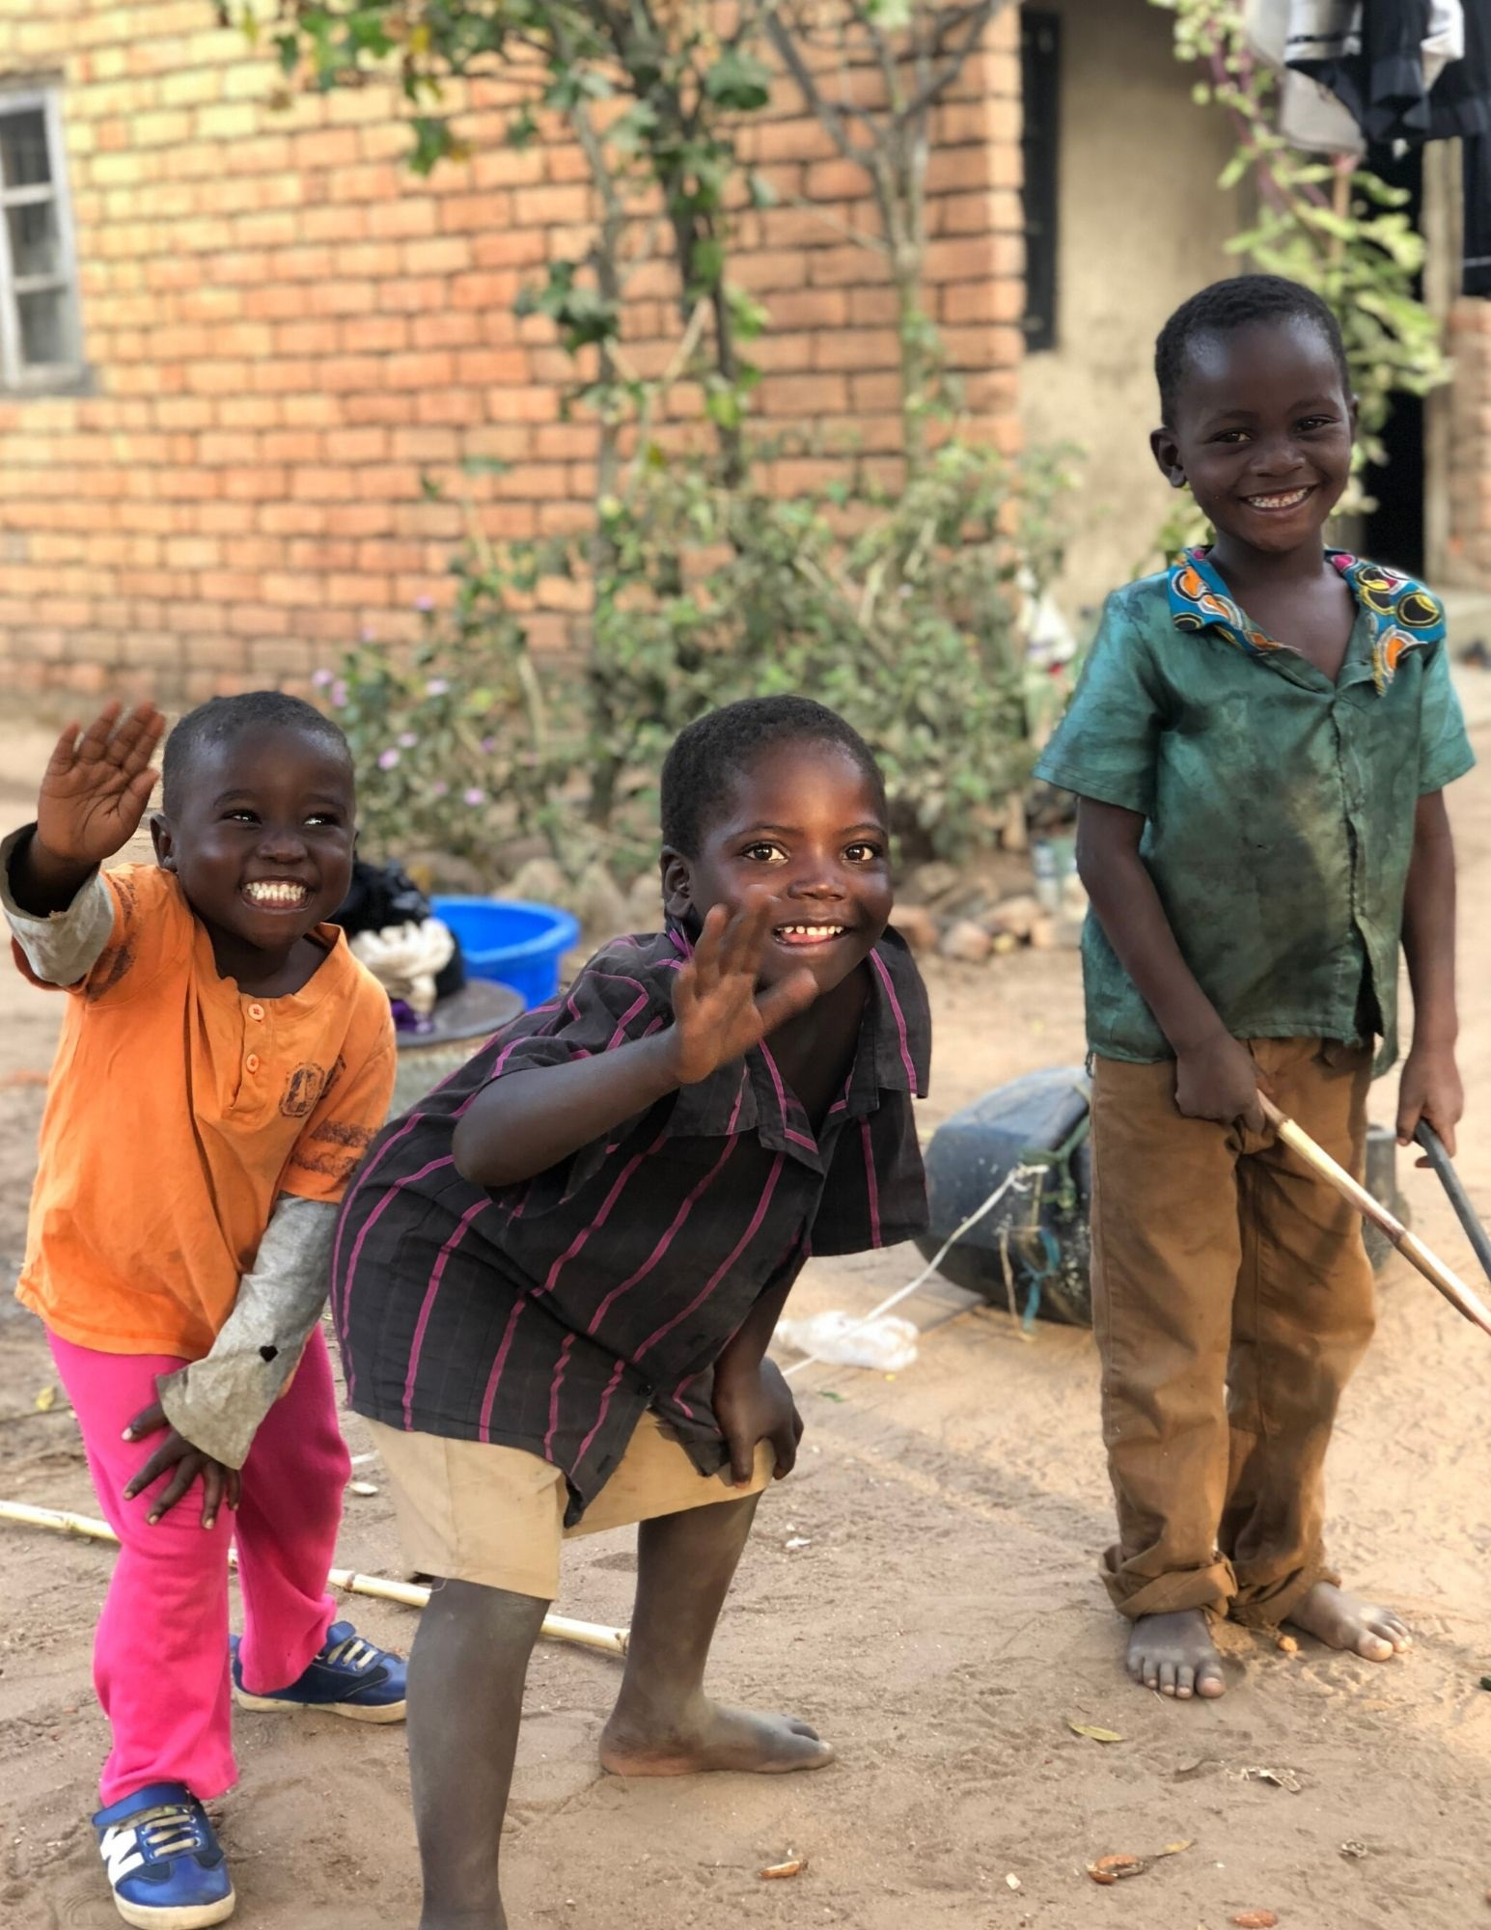
Conclusion
Automating Pneumonia Diagnosis
Save Lives
Improve accuracy from 85% to 94%
Increase healthcare accessibility
Help children like Ruth reach their fifth birthday plus many more
Other Benefits
Cost Savings= $17.2 million cost savings in Malawi alone
Innovation = Opens the door to expand our model to other diseases and countries around the world
Notes:
We recommend that our model be implemented to help automate the diagnosis of pneumonia in developing countries like Malawi. The potential cost savings of about $17.2 million that our model can provide in this country alone is very significant. In addition, the improvement in accuracy from 85% to about 94% from using our model means thousands of lives are also saved. The $2,000,000 in funding will allow us to pilot this deep learning model and make a tangible difference in the lives of those who need it most.

Slide 22
BKMD Capital
THANK YOU
We Appreciate Your Consideration
Telephone
Address
Website
February 2024
+212-515-3200
9 W 57 St., New York,
NY 10016
www.bkmd/capitalpartners.com

Slide 23
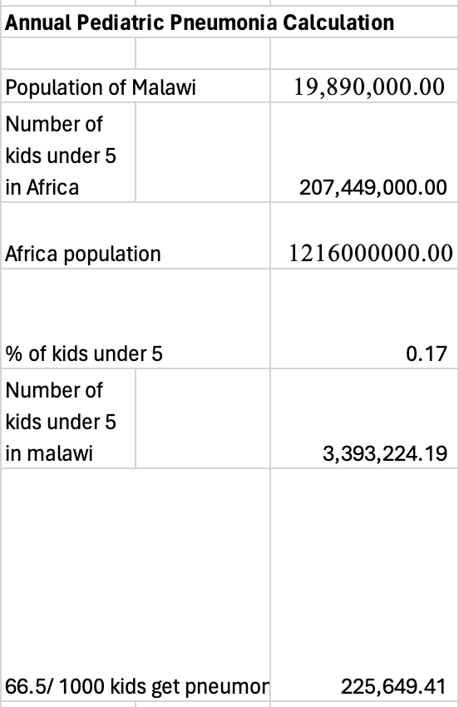
Appendix
Calculations
01
https://jscholarship.library.jhu.edu/items/69fee8d2-15bb-4e33-8aee-ec1eb8f24f36
https://www.statista.com/statistics/1226211/population-of-africa-by-age-group/
https://www.ncbi.nlm.nih.gov/pmc/articles/PMC3345619/#:~:text=French%20has%20estimated%20that%20the,70%25%20will%20be%20HIV%20associated

Slide 24
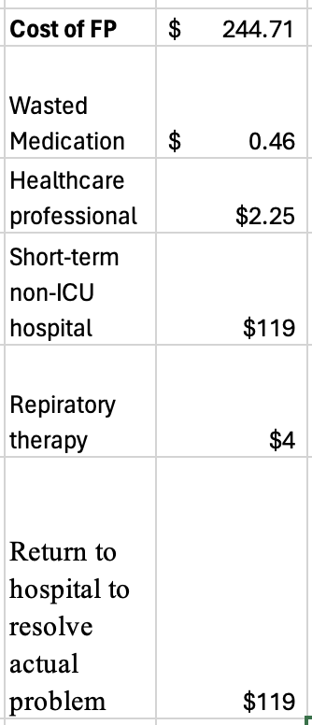
Appendix
02
At least 40 kg: 500 mg orally every 8 hours or 875 mg every 12 hours, 15 capsules
https://www.health.gov.za/wp-content/uploads/2021/03/HP02-2019AI-Add-2-15-CPA-Effective-1-April-2020.pdf
$0.375 per hour x 6 hours = $2.25
https://bdeex.com/malawi/?type=medicine#google_vignette
Mean cost per bed/day
https://www.ncbi.nlm.nih.gov/pmc/articles/PMC8782501/
https://www.erieri.com/salary/job/respiratory-therapy-technician/south-africa
https://www.ncbi.nlm.nih.gov/pmc/articles/PMC8782501/

Slide 25
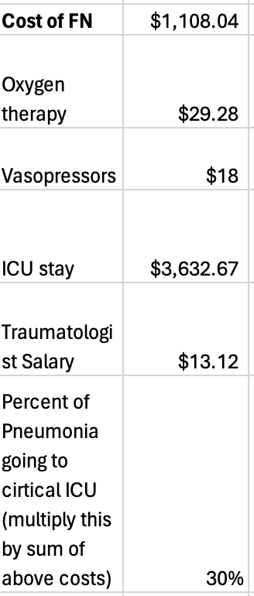
Appendix
03
Oxygen therapy to treat respiratory failure = $7.32 per hour, 4 hours, $29.28,
https://elifeonline.net/cost-of-oxygen/
Treat patients in septic shock (norepinephrine and vasopressin), cost $40, 46% untreated pneumonia chance of going into sepsis = $18.40
https://bdeex.com/malawi/?type=medicine#google_vignette
ZAR22 870= $1210.89
3 days of ICU $3632.67
https://pubmed.ncbi.nlm.nih.gov/30606302/
4 day cost, 8 hours a day = $13.12
https://bdeex.com/malawi/?type=medicine#google_vignette
https://erj.ersjournals.com/content/18/1/151

Slide 26
Appendix
Model Tuning Process Tracking Sheet
https://docs.google.com/spreadsheets/d/1ktDvrfFREljriblMR7JcYPz3REncYQ32oAgET9th0Mo/edit#gid=0

